Slide 1
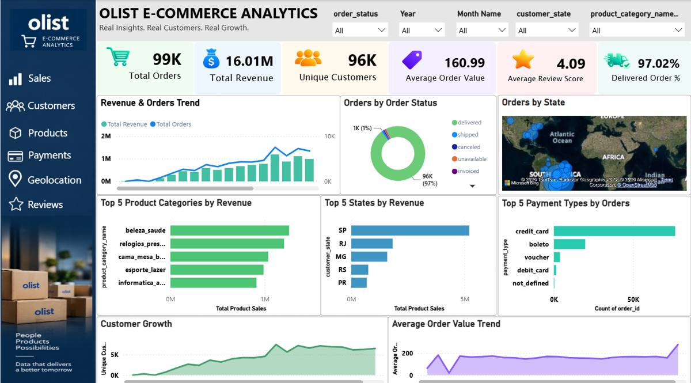
OLIST
E-COMMERCE ANALYTICS
Interactive Power BI Dashboard & Business Analysis
DATA ANALYST CASE STUDY
Power BI • Power Query • DAX • Data Modeling

Slide 2
Project Overview
From raw Brazilian e-commerce data to an interactive BI solution
• Analyzed Olist e-commerce data covering orders, customers, products, sellers, payments, reviews and locations.
• Built seven Power BI pages: Overview, Sales, Customers, Products, Payments, Geolocation and Reviews.
• Prepared data with Power Query and created reusable DAX measures for KPIs, growth and customer metrics.
• Designed the report for interactive exploration through slicers, maps, matrices and page navigation.
99K
16.01M
Total Orders
Total Revenue
96K
4.09
Unique Customers
Avg. Review Score
Primary analysis areas
• Sales & revenue trends
• Customer behavior
• Product/category performance
• Payments & installments
• Geographic distribution
• Customer reviews

Slide 3
Dataset & Data Model
Business entities represented across the Olist analytical model
Table
Table
Table
Customers
Orders
Order Items
Table
Table
Table
Payments
Reviews
Products
Table
Table
Table
Sellers
Geolocation
Category Translation
Modeling highlights
• DateTable connected to order dates for time-based analysis and YoY calculations.
• Order Items connects sales activity with Orders, Products and Sellers.
• Payments and Reviews connect back to Orders for transaction and feedback analysis.
• Geolocation was aggregated at ZIP-prefix level for geographic visualization.

Slide 4
Overview Dashboard
Executive view of orders, revenue, customers, delivery and high-level trends.

Slide 5
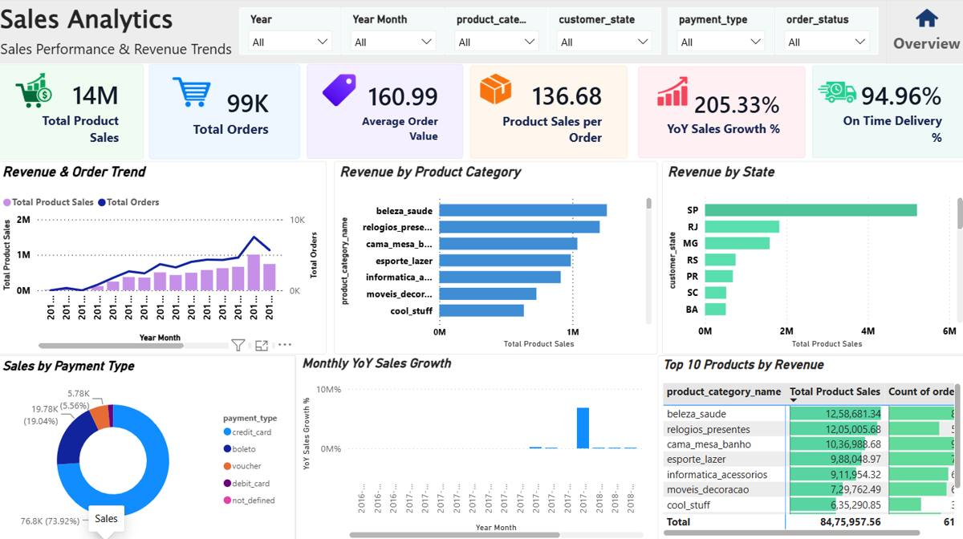
Sales Analytics
Revenue, order trends, category/state performance, payment mix and YoY growth.

Slide 6
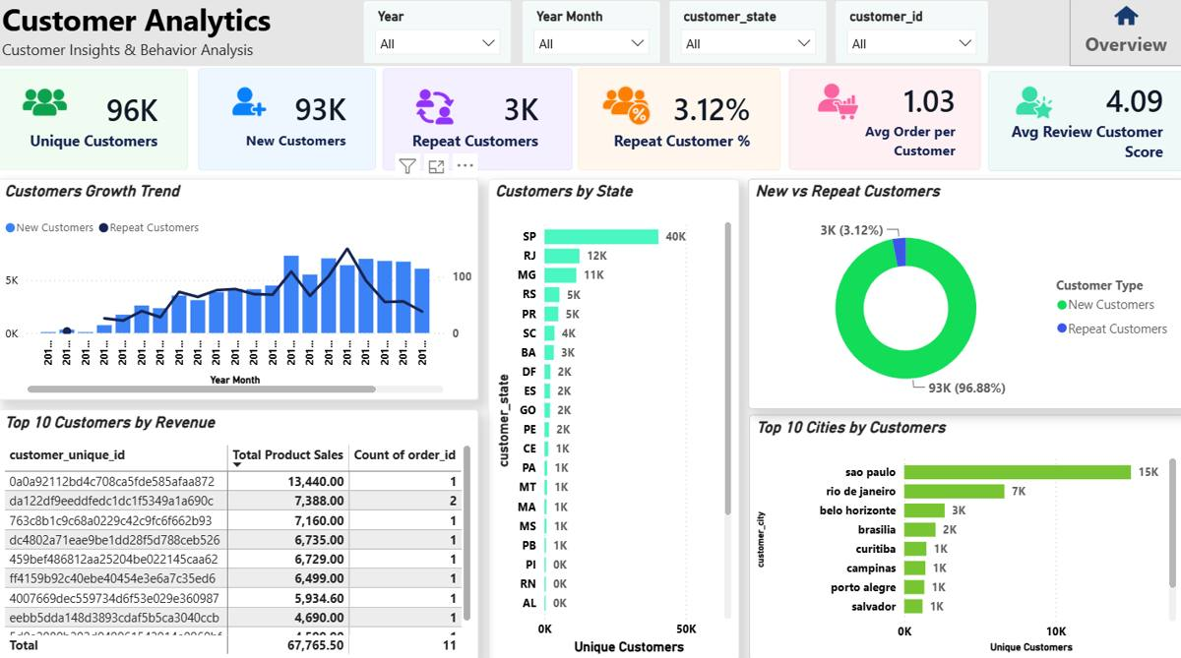
Customer Analytics
Customer growth, new vs repeat customers, state/city distribution and top customers.

Slide 7
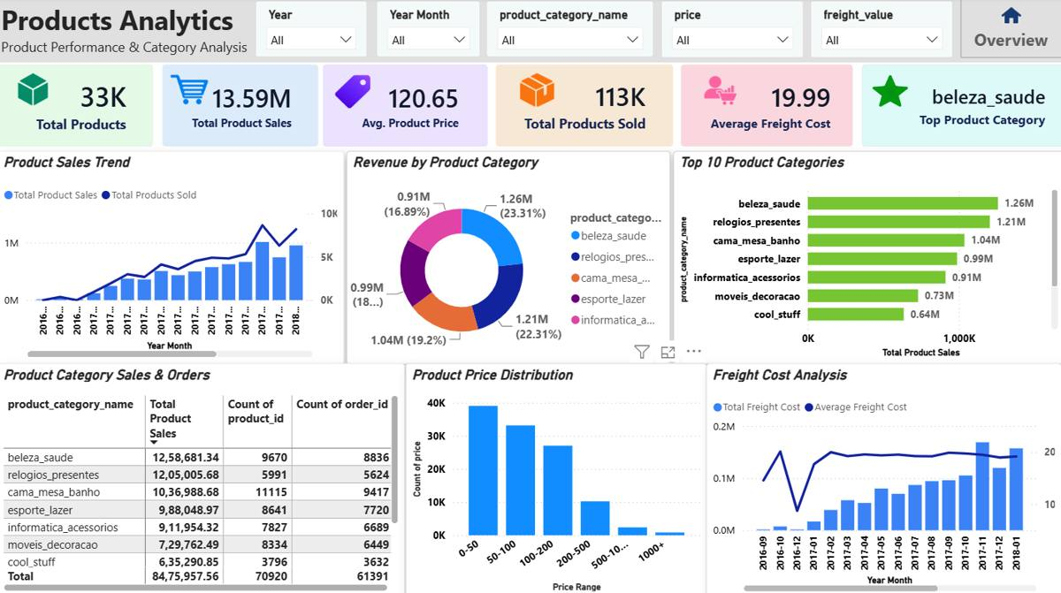
Products Analytics
Product sales, category performance, price distribution and freight-cost analysis.

Slide 8
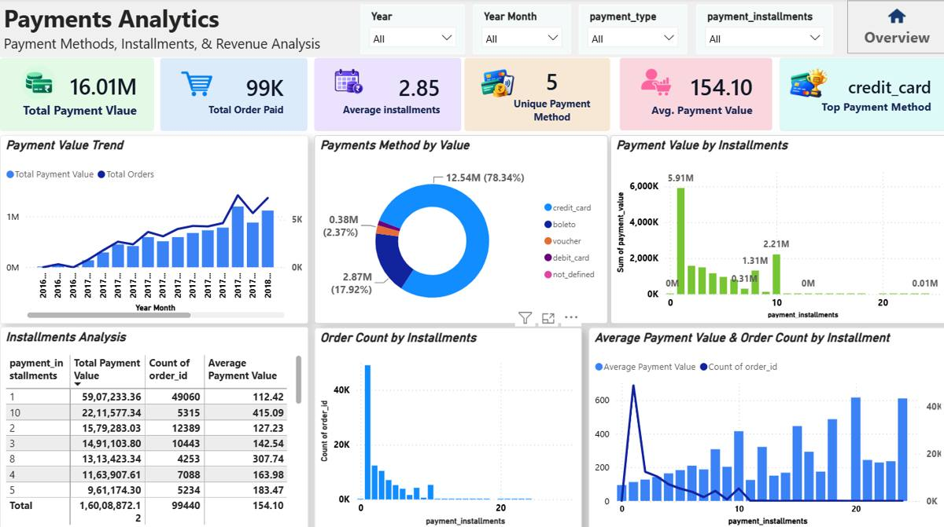
Payments Analytics
Payment value, methods, installments and transaction-level payment patterns.

Slide 9
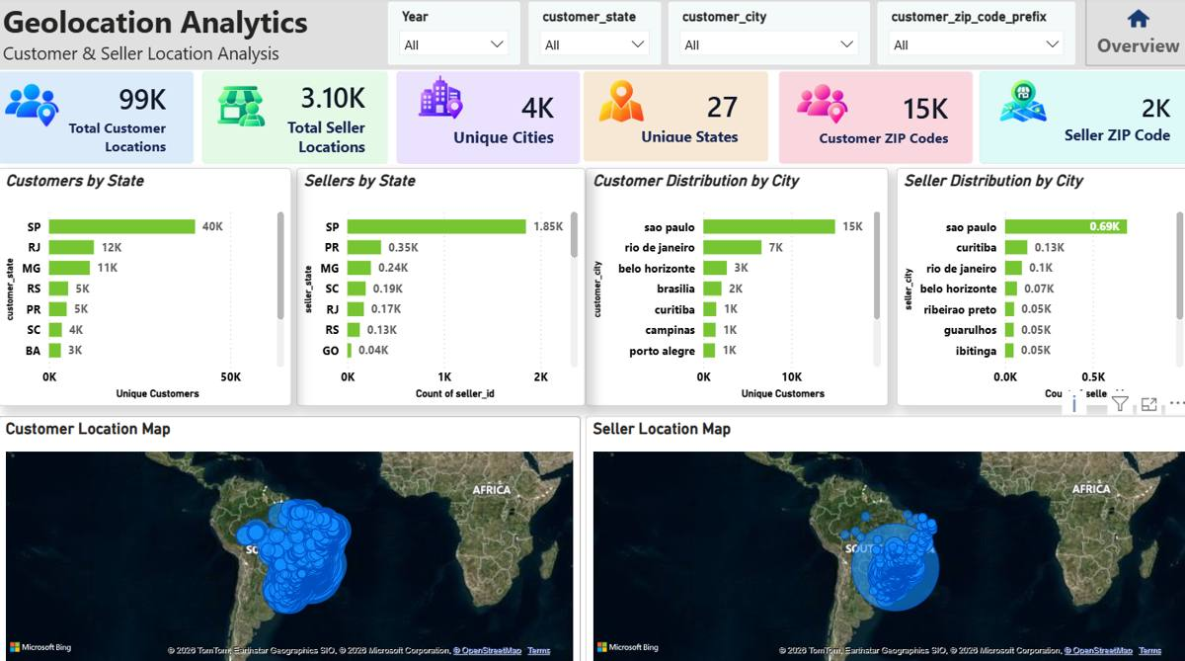
Geolocation Analytics
Customer and seller distribution across states, cities and geographic locations.

Slide 10
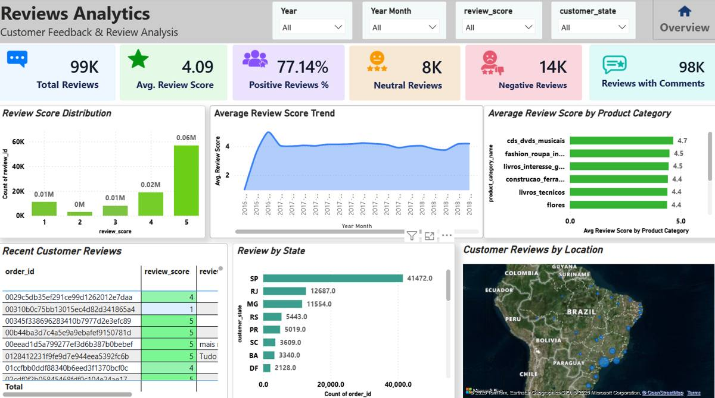
Reviews Analytics
Review distribution, score trends, category performance, state activity and recent feedback.

Slide 11
Key Dashboard Insights
Values and observations visible in the completed dashboard
96K unique customers; repeat customers are shown at 3.12%.
97.02% delivered-order rate; Sales page shows 94.96% on-time delivery.
Customer base
Delivery
beleza_saude is the top product category by product sales on the dashboard.
credit_card is the dominant payment method by value; 78.34% is shown.
Products
Payments
São Paulo leads the customer/city visuals and SP leads state-level activity.
Average review score is 4.09 and positive reviews are shown at 77.14%.
Reviews
Geography

Slide 12
Skills Demonstrated
What this project demonstrates for a Data Analyst portfolio
Dashboard design, slicers, maps, matrices, navigation and interactive reporting.
Data profiling, cleaning, transformations and preparation.
Power BI
Power Query
KPI measures, time intelligence, growth calculations and business logic.
Relationships, DateTable, filter propagation and analytical structure.
DAX
Data Modeling

